Slide 1
Integer Sequence Learning and its Applications
Pranav Nanga

Slide 2
The Problem
Given a sequence of integers, can you predict the next number?
2, 3, 5, 7, 11, … 13
A human can recognize this as the primes, but a computer might have more trouble
1, 2, 3, 4, 5, … 7?
A human would probably predict 6 instead of 7
However this is the sequence of prime powers, not the counting numbers
Can a computer be trained to beat a human?
End goal – develop a model that can be applied to real world data
Sequences like these appear everywhere – a model that can extrapolate would be immensely useful

Slide 3
The Data
Thanks to the mathematicians, we have the massive Online Encyclopedia of Integer Sequences at our disposal
First, let’s explore the data

Slide 4
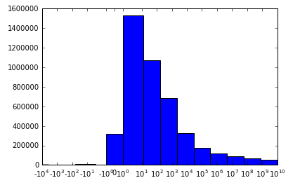
Data Exploration
This histogram shows the most common numbers in the given sequences
While most sequences are under 1000, a significant amount appear exponential – reaching as high as 10¹⁰

Slide 5
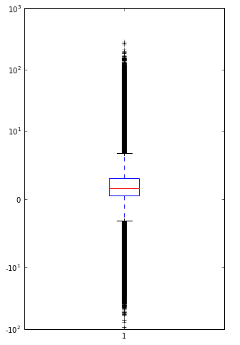
Data Exploration, continued
The boxplot confirms the story told by the histogram – that most data is on the order of 10s, 100s, and 1000s
There are a significant number of outliers in both positive and negative directions

Slide 6
What does this mean?
Machine Learning – a method to train computers on datasets to let them extrapolate new data
Many different methods with their own pros and cons
We don’t like outliers because they make prediction harder and models more involved
A simple model is best to avoid overfitting to the data given
Overfitting – conforming a model too specifically to a dataset so it performs badly on new data
HOWEVER, real-world data is often ugly and an effective model should deal with complications

Slide 7
First approach – Individual Regression
Intuitively, humans would try to find a pattern in the given sequence
Translated to computer, this involves fitting a regression model to each sequence
Three methods were tested
Linear – using the line of best fit
Polynomial – using the polynomial that best fits the data
Smoothing – averaging portions of the sequence to form a new sequence and regressing that

Slide 8
Individual Regression Results

Slide 9
Regression Results Explained
Accuracy was low across the board – hard to predict the exact value
R^2 provides measure of model that rewards being close enough
Scale from 0-1, closer to 1 is better
More translatable to real-world application
Using R^2, both linear based models were favored
Perhaps polynomial models suffered from overfitting problem
We need a better method

Slide 10
Holistic Regression Models
Instead of fitting regressions to each sequence individually, why not use the entire dataset?
Takes longer to train computer, but hopefully increases accuracy
Instead of using just the sequence itself, features calculated
Features – descriptors of sequence used to amplify predictions
Example features – mean, standard deviation, autocorrelation, numbers in sequence
Three types tested
Linear – similar to previous
Support Vector
Random Forest

Slide 11
Holistic Regression Results
These methods were significantly better than the individual sequence methods
R^2 values of 0.8-0.9, compared to 0.5-0.6
For application, speed a huge factor
RFR was not only accurate, but very fast comparatively

Slide 12
Applications and Conclusions
While the research here was very theoretical, sequences like these appear in many settings
Stock market
Weather patterns
Migration behavior
Business metrics
Machine learning methods can be used for decision making in these scenarios
Can make predictions with levels of confidence to aid humans
Random Forest Regression proved both fast and accurate, making it a prime candidate for application to industry and science

